Slide 1



ORBITAL MECHANICS
INTERPLANETARY MISSION FROM MERCURY TO EARTH
PLANETARY MISSION ON EARTH WITH LUNAR PERTURBATIONS
LAUREA MAGISTRALE
SPACE ENGINEERING
Presented by
Prof Camilla Colombo
Azevedo Da Silva Esteban
11072547 - 277079
Donati Filippo
10797598 - 280181
Domenichelli Eleonora
10797598 - 280323
Pantoja Gavidia Maria Paulina
11021048 - 272281
Group 2427 Tzintzun
Academic year 2024/2025

Slide 2



The interplanetary trajectory involves departure from Mercury, a gravity-
assist maneuver at Earth, and arrival at Asteroid No. 30.
01
02
The earliest departure is set for January 1, 2030, and the latest arrival on January 1, 2060.
INTERPLANETARY MISSION
03
The feasibility analysis evaluates the mission’s viability using the total cost in terms of ∆vtot

Slide 3
Constraints and assumptions
Using patched conics method
Altitude during the flyby: Limited to a minimum of approximately 2000 km.
Planetary departure and insertion maneuvers: Excluded from the analysis.
Initial heliocentric orbit: Assumed to match the departure planet's orbit, with the final orbit aligned to the arrival body's orbital parameters.
Δv maneuvers: Treated as instantaneous events, neglecting burn duration
Non-gravitational forces: Solar radiation pressure, atmospheric drag, and other forces were disregarded.

Slide 4
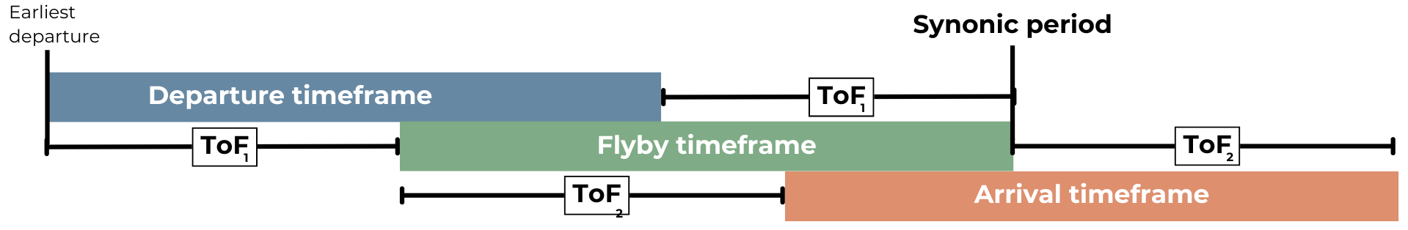
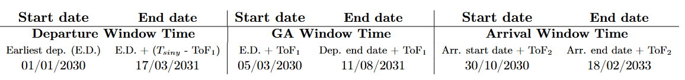
Transfer windows and preliminary estimations
Based on the synodic period analysis, the departure window, flyby timeframe, and arrival window were determined using Hohmann transfer times and alignment constraints

Slide 5
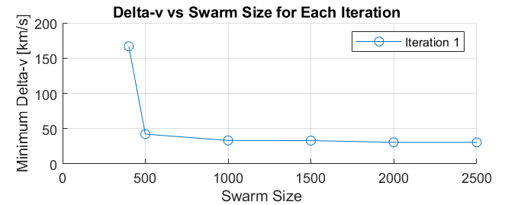
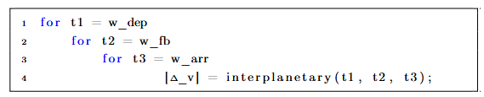
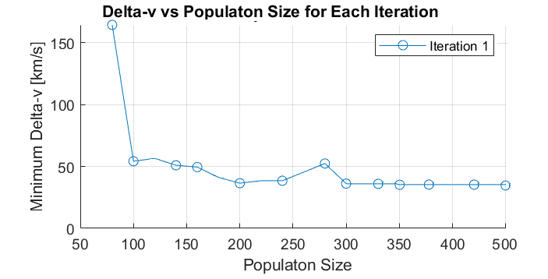
DESIGN STRATEGY
01
The Differential Evolution Algorithm was implemented using Particle Swarm Optimization (PSO) with a swarm size of 2000 particles
The Grid Search method was implemented considering the three degrees of freedom—departure date, flyby date, and arrival date— with an adjusted step of 10 days.
02
03
The Genetic Algorithm was employed with a population of candidate solutions of at least 300 individuals ensured reliable convergence while maintaining computational efficiency

Slide 6
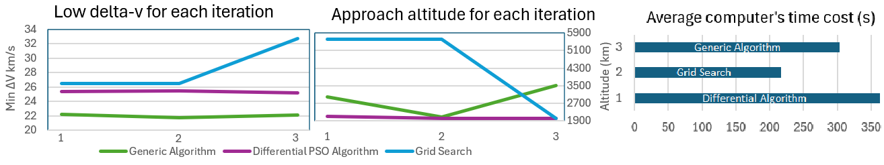
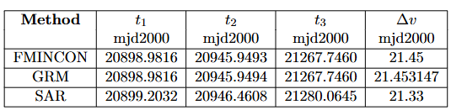

To enhance the solutions provided by the Generic Algorithm, three refinement methods—FMINCON, Gradient Refining Method (GRM), and Simulated Annealing Refinement (SAR)—were utilized by implementation of a conditional selection mechanism that consistently identified the optimal solution.

Slide 7

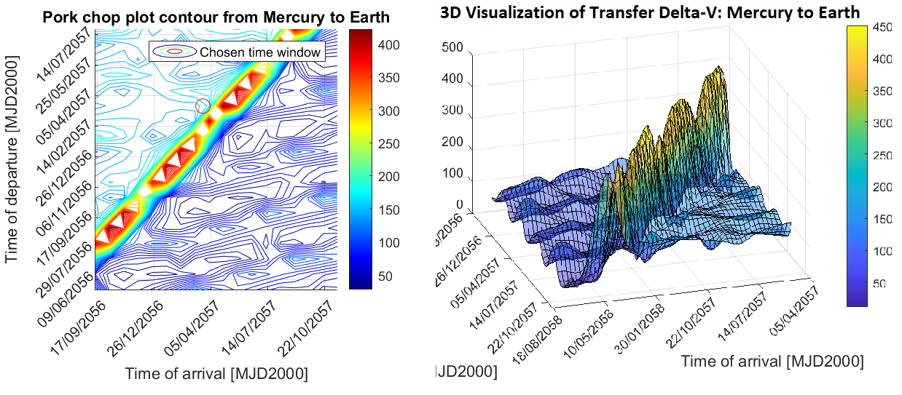
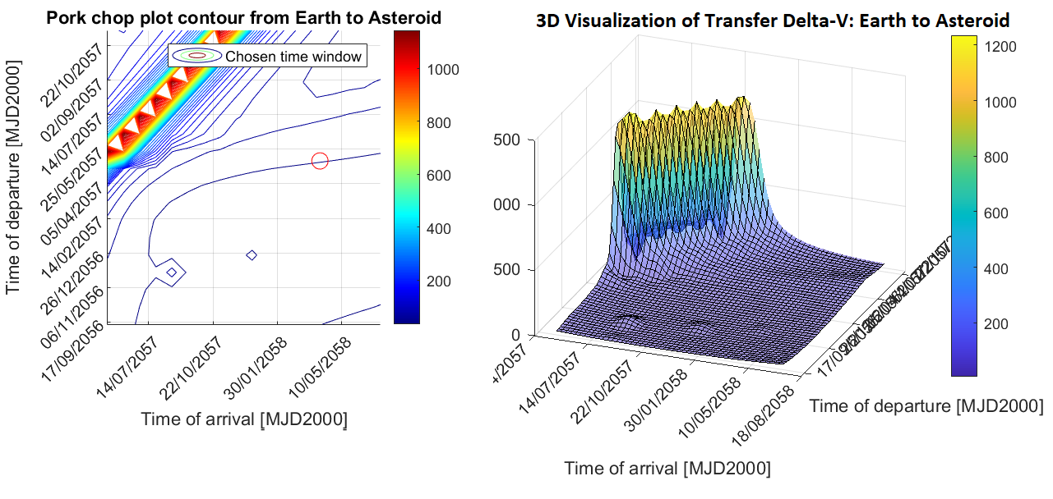
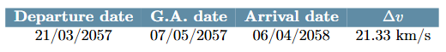
ORBITAL CHARACTERIZATION
Transfer Window Visualization
The optimal solution, derived from the Lambert Problem using the Genetic Algorithm and refined with Simulated Annealing PSO, is summarized in Table , supported by the visualization of the launch window.

Slide 8
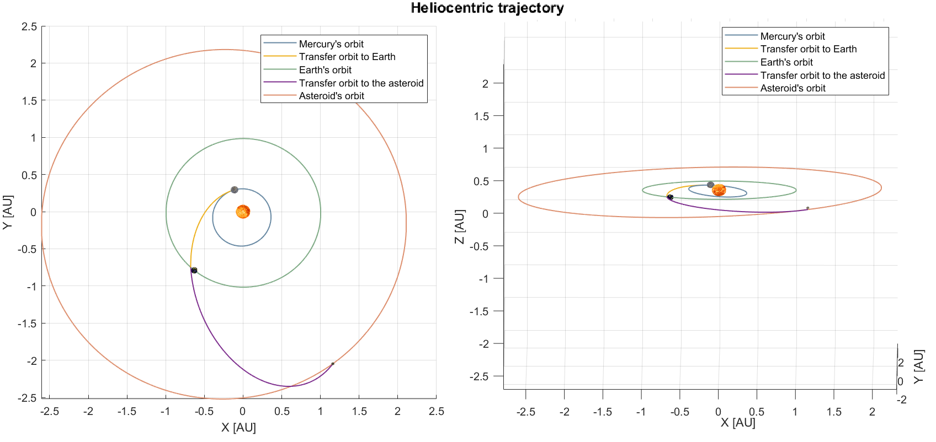
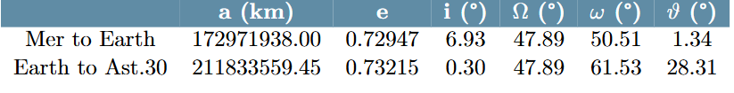
ORBITAL CHARACTERIZATION
Heliocentric Trajectory
After the optimization, two Lambert transfer arc were solved.
The yellow one from Mercury to Earth.
The purple one from Earth to the Asteroid 30.
Ephemerides gave the Keplerian elements of each Mercury, Earth and the Asteroid at each optimal time computed.

Slide 9
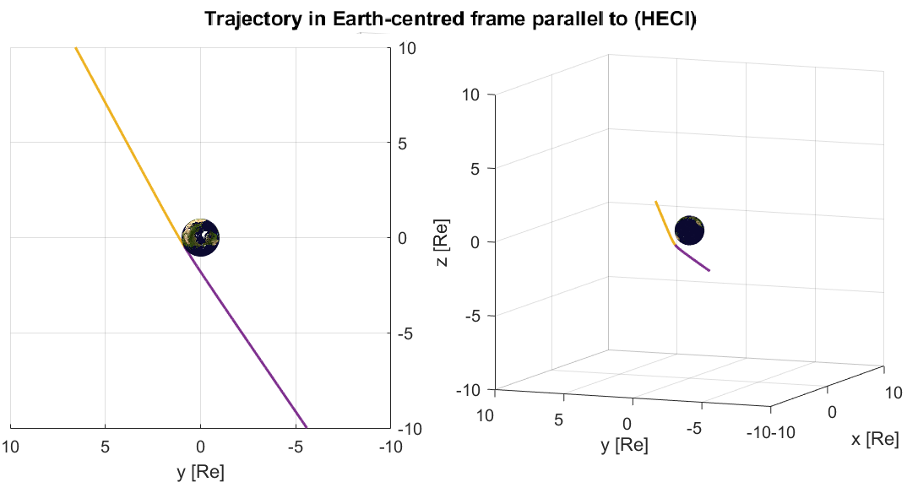
ORBITAL CHARACTERIZATION
Powered Gravity Assist Maneuver
Reaching Earth, a powered fly-by was made to gain speed and calibrate the leg direction to reach the Asteroid.
Constraint CA > 2000 km
---> CA = 2332.78 km
The yellow one from Mercury to Earth.
The purple one from Earth to the Asteroid 30.
Ephemerides gave the Keplerian elements of each Mercury, Earth and the Asteroid at each optimal time computed.

Slide 10
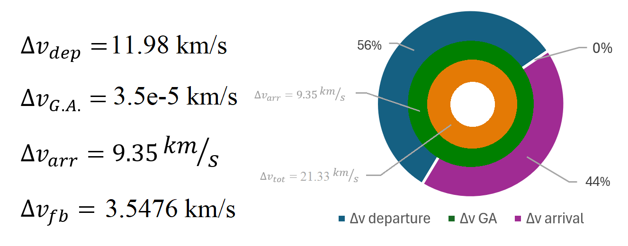
Results distribution

Slide 11
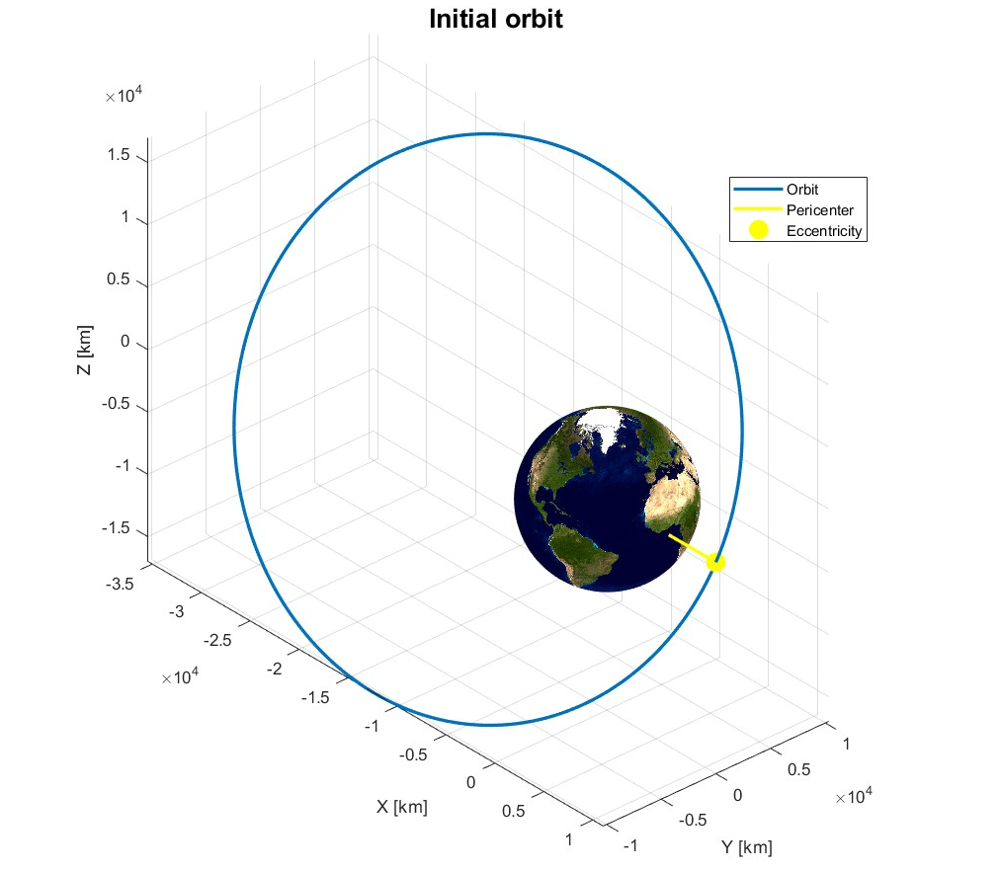
PLANETARY EXPLORER MISSION
Initial orbit characterization
Prograde orbit in MEO;
Orbital period: T = 35395 s ~ 9.8 h;
Starting date of propagation: 2057/05/08 23:20:30.
a [km] | e [-] | i [deg] | Ω [deg] | ω [deg] | θ [deg]
23300 | 0.5230 | 58.65 | 0 | 0 | 0
Assigned perturbations:
J2 effect (Earth's oblateness);
Moon's gravitational effect.

Slide 12
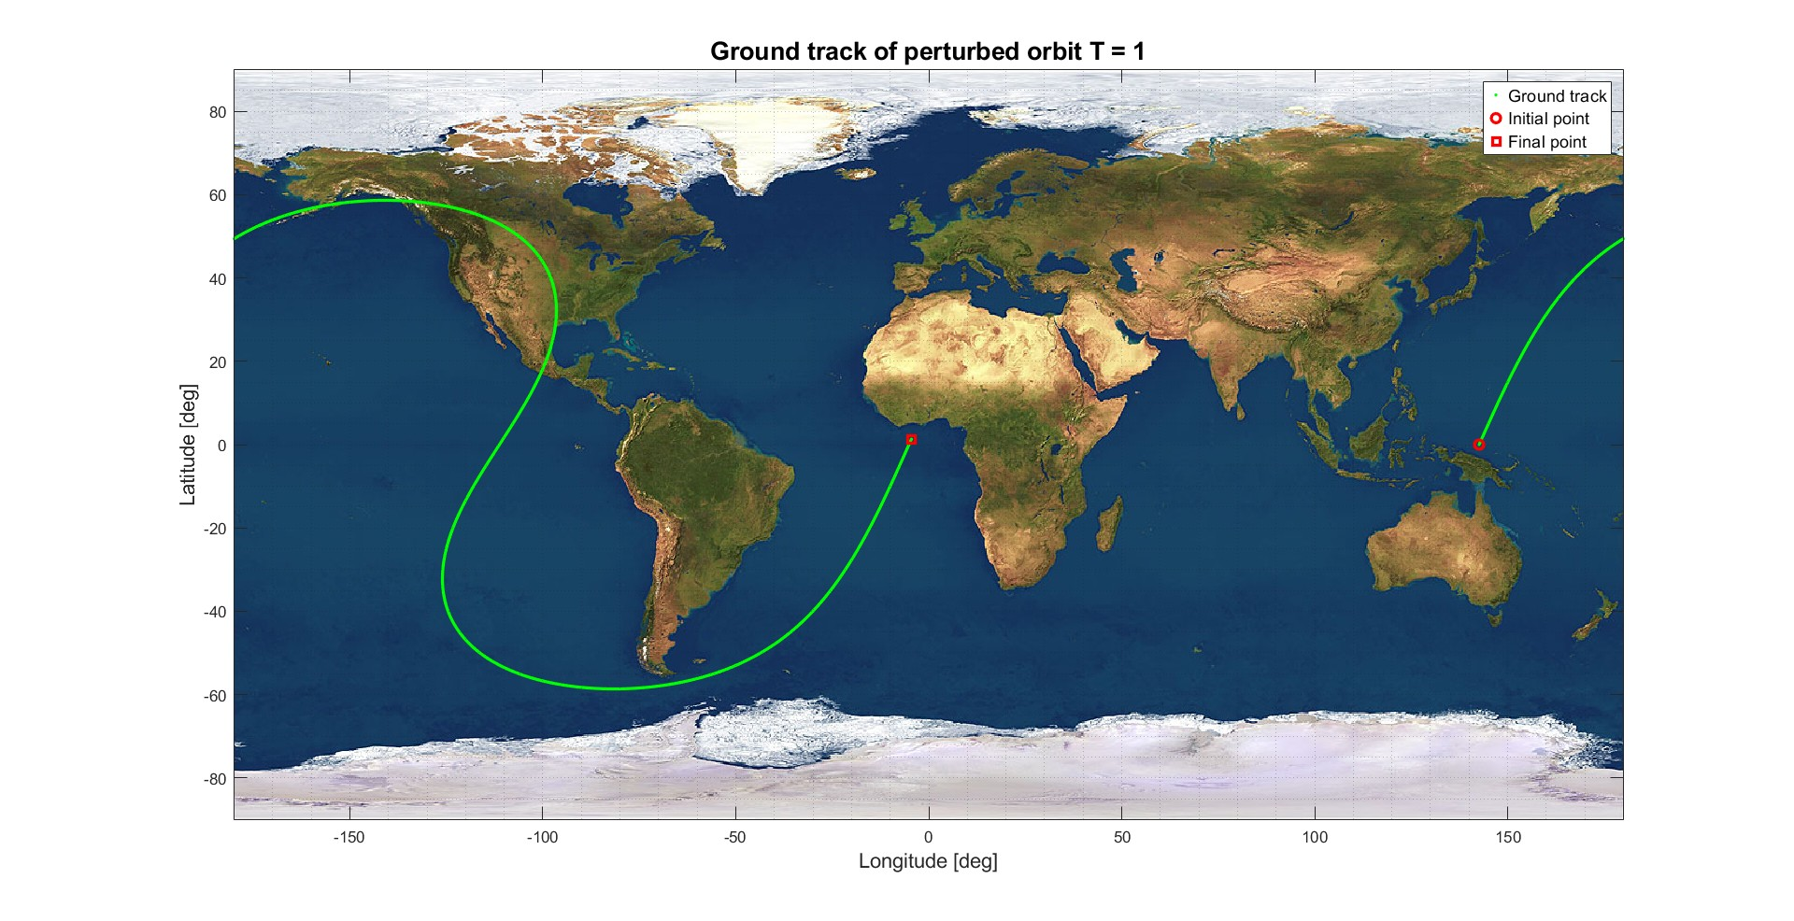

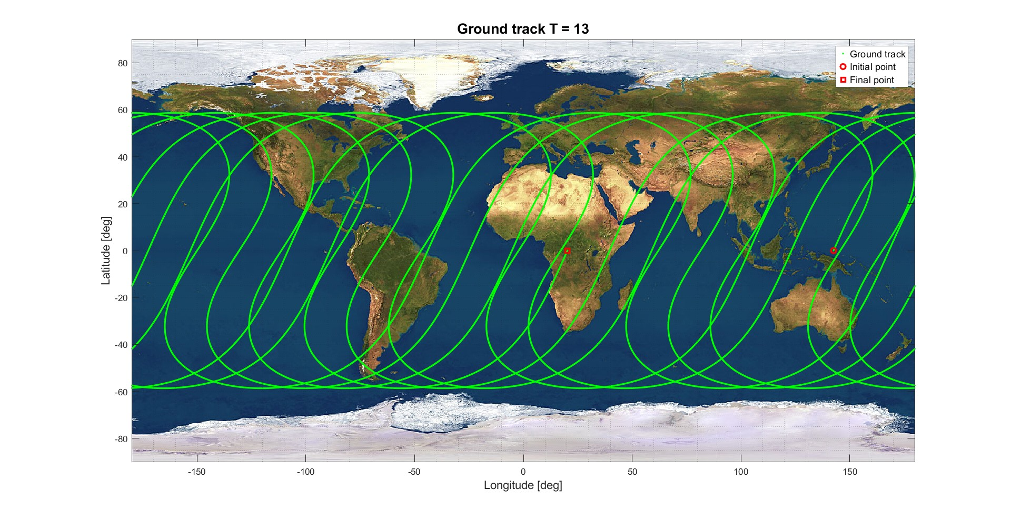
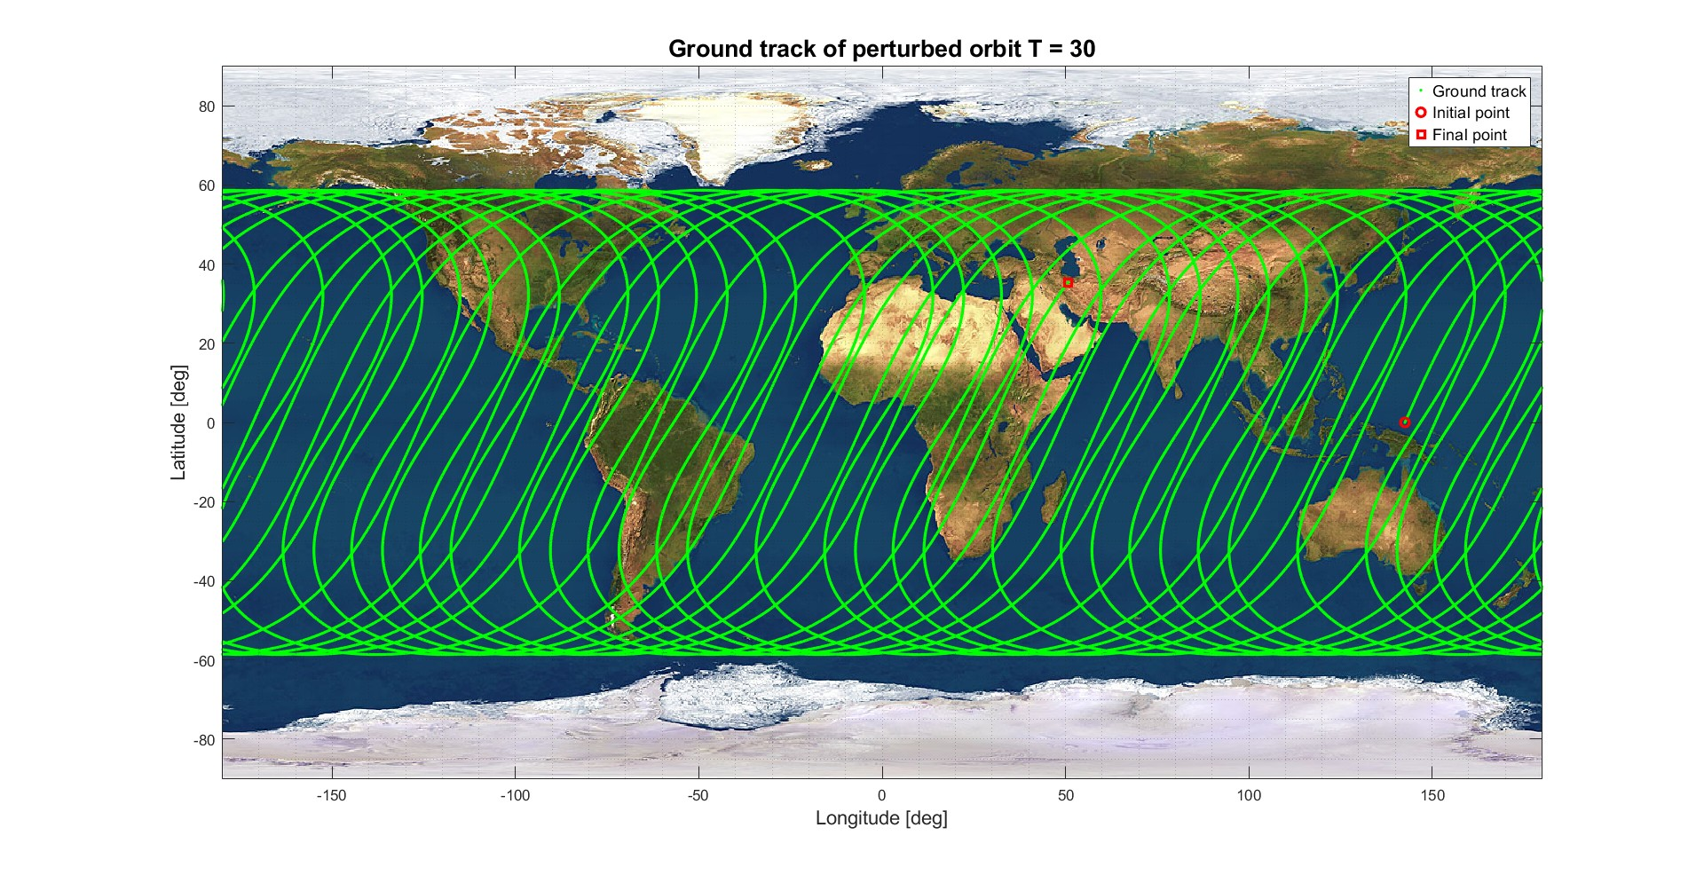


GROUND TRACK
Unperturbed
Perturbed
Δλ = -T*ωe = -147.8 deg (in the weastward direction)

Slide 13
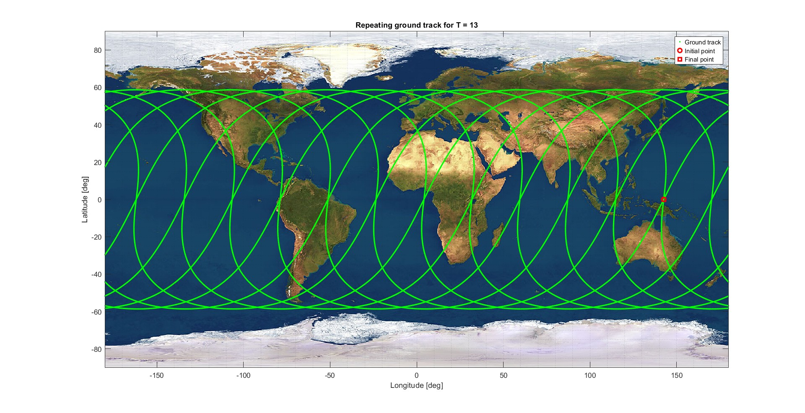

REPEATING GROUND TRACK
Unperturbed
Perturbed
Semi-major axis = 15864 Km
Δλ = −83.07 deg
K = 13
M = 3

Slide 14
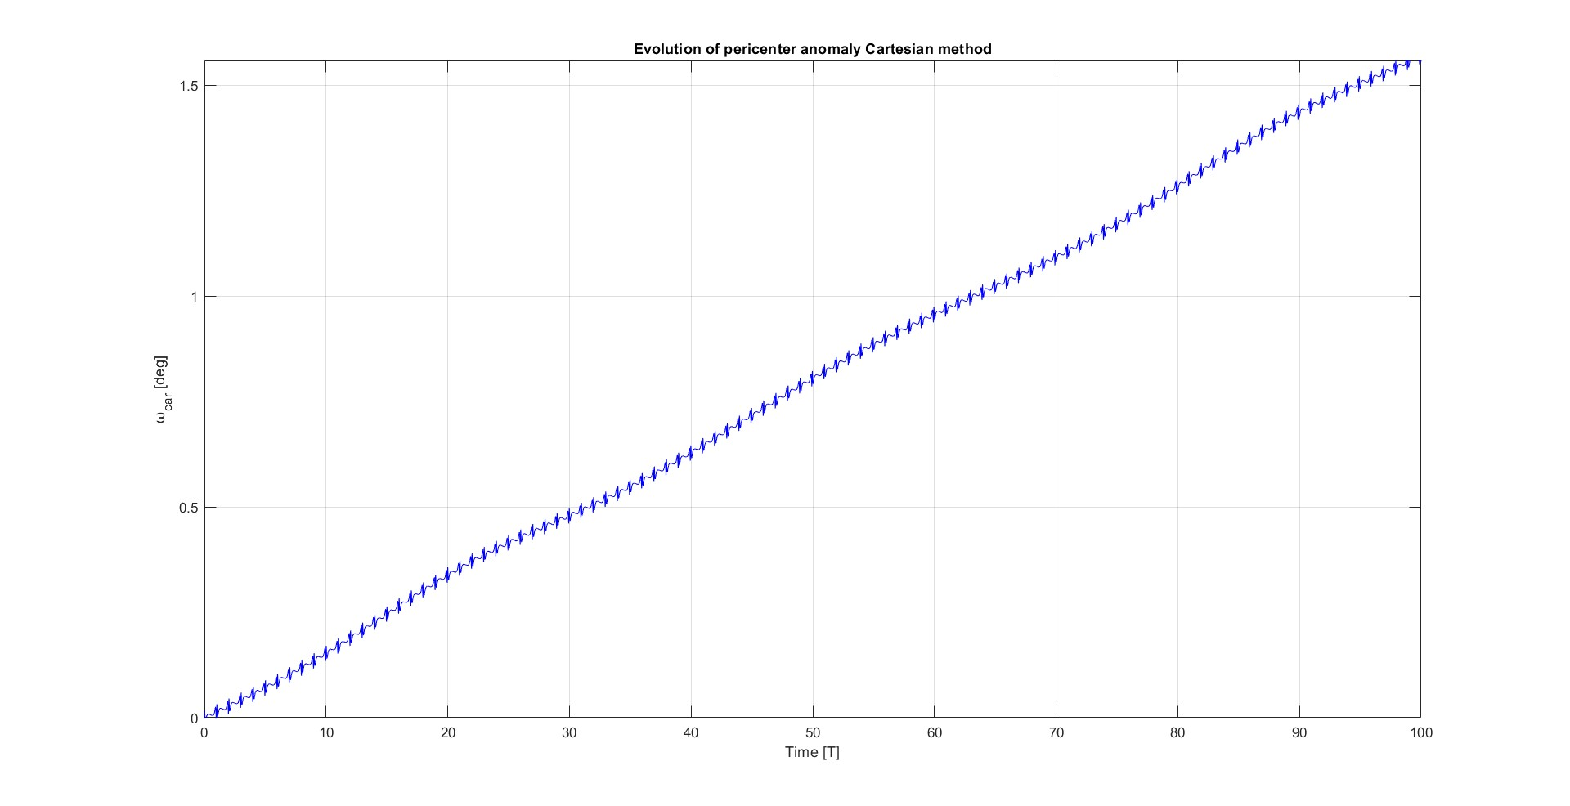
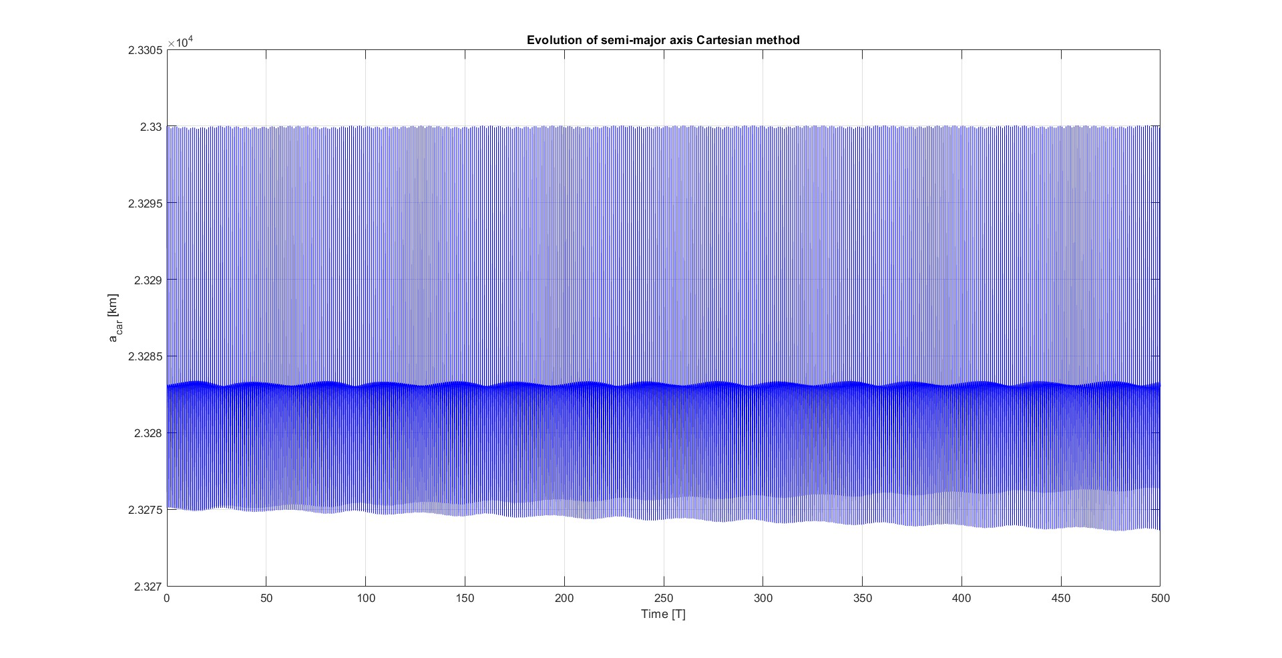
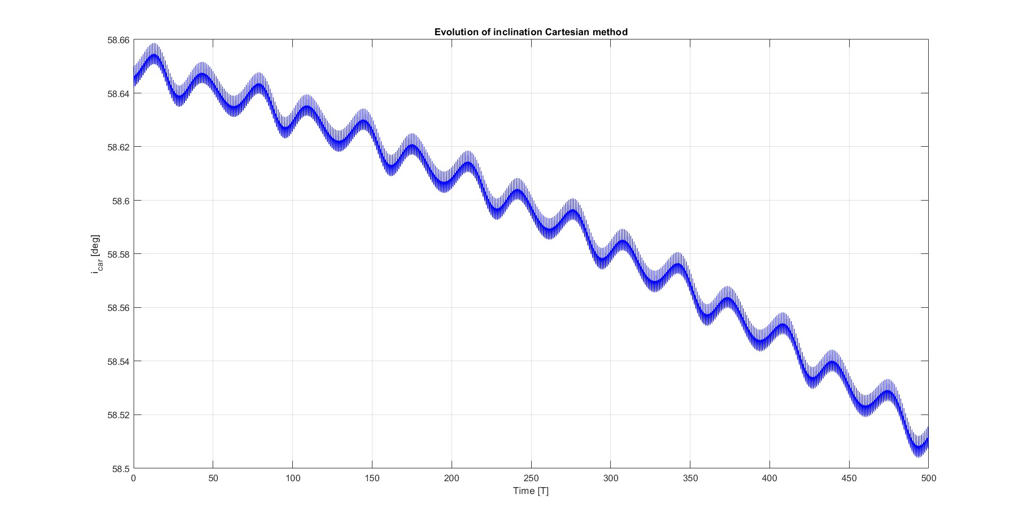
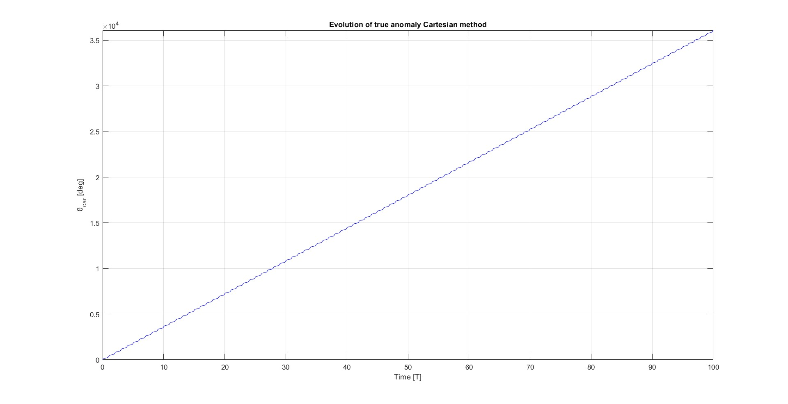
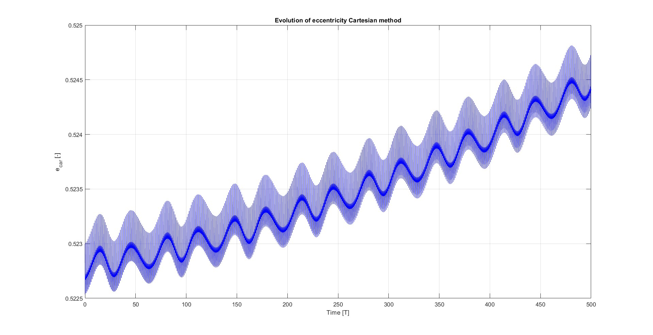
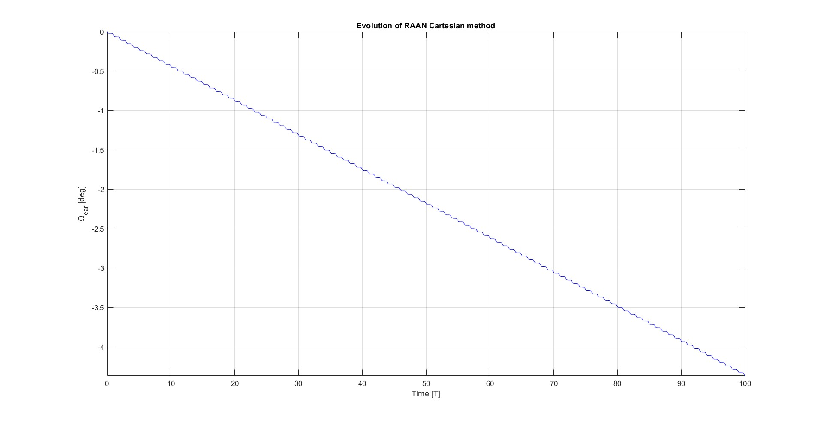
KEPLERIAN PARAMETERS PROPAGATION
Three distinct behaviours revealed by the graphs:
Short-term oscillations of all elements, caused by orbit's dynamics;
Long-term oscillations of e, i and ω, driven by the gravitational influemce of the Moon;
Secular effects on Ω and ω, from J2.

Slide 15
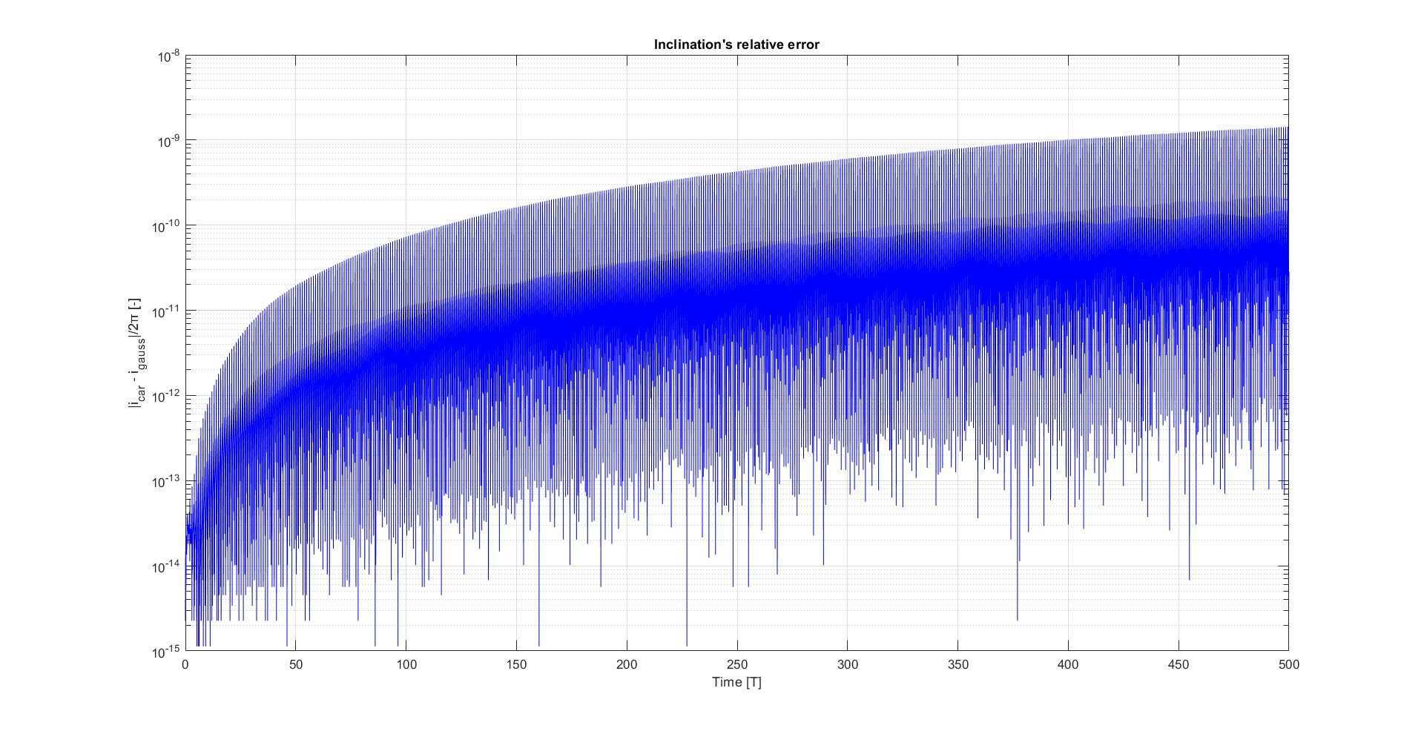
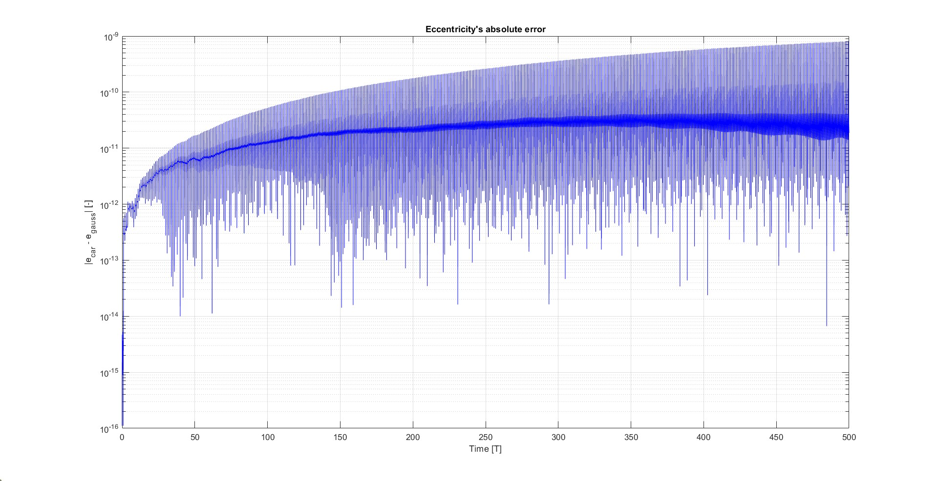
KEPLERIAN PARAMETERS PROPAGATION
Propagation methods comparison
Two propagation methods:
Cartesian coordinates propagation;
Keplerian elements propagation through Gauss planetary equations.
PROPAGATION SETTINGS:​
ode113
Reltol = 1e-13
Abstol = 1e-14
500 orbits
ACCURACY almost same behaviour
COMPUTATIONAL EFFICIENCY Gauss method faster

Slide 16
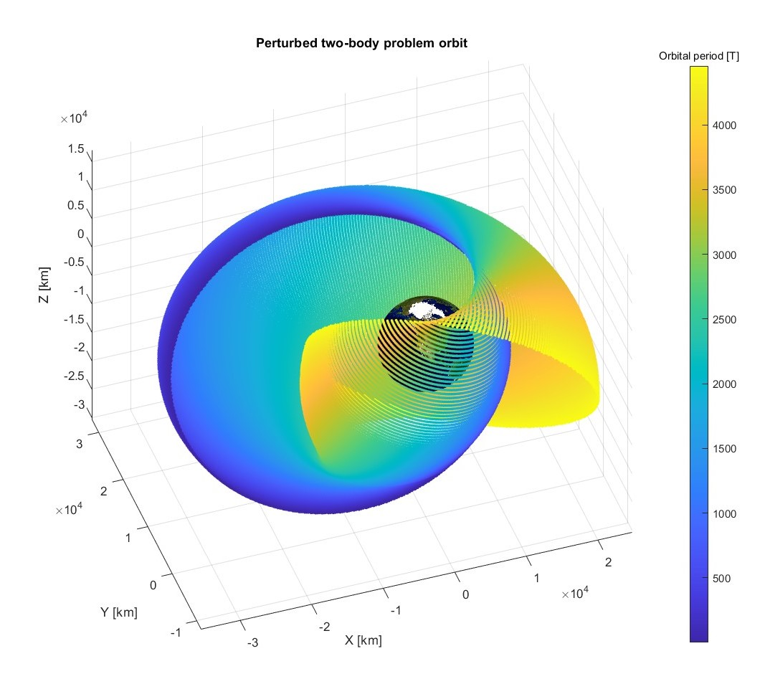
ORBIT REPRESENTATION
Simulated for 4455 Orbital Revolutions
(5 years)

Slide 17
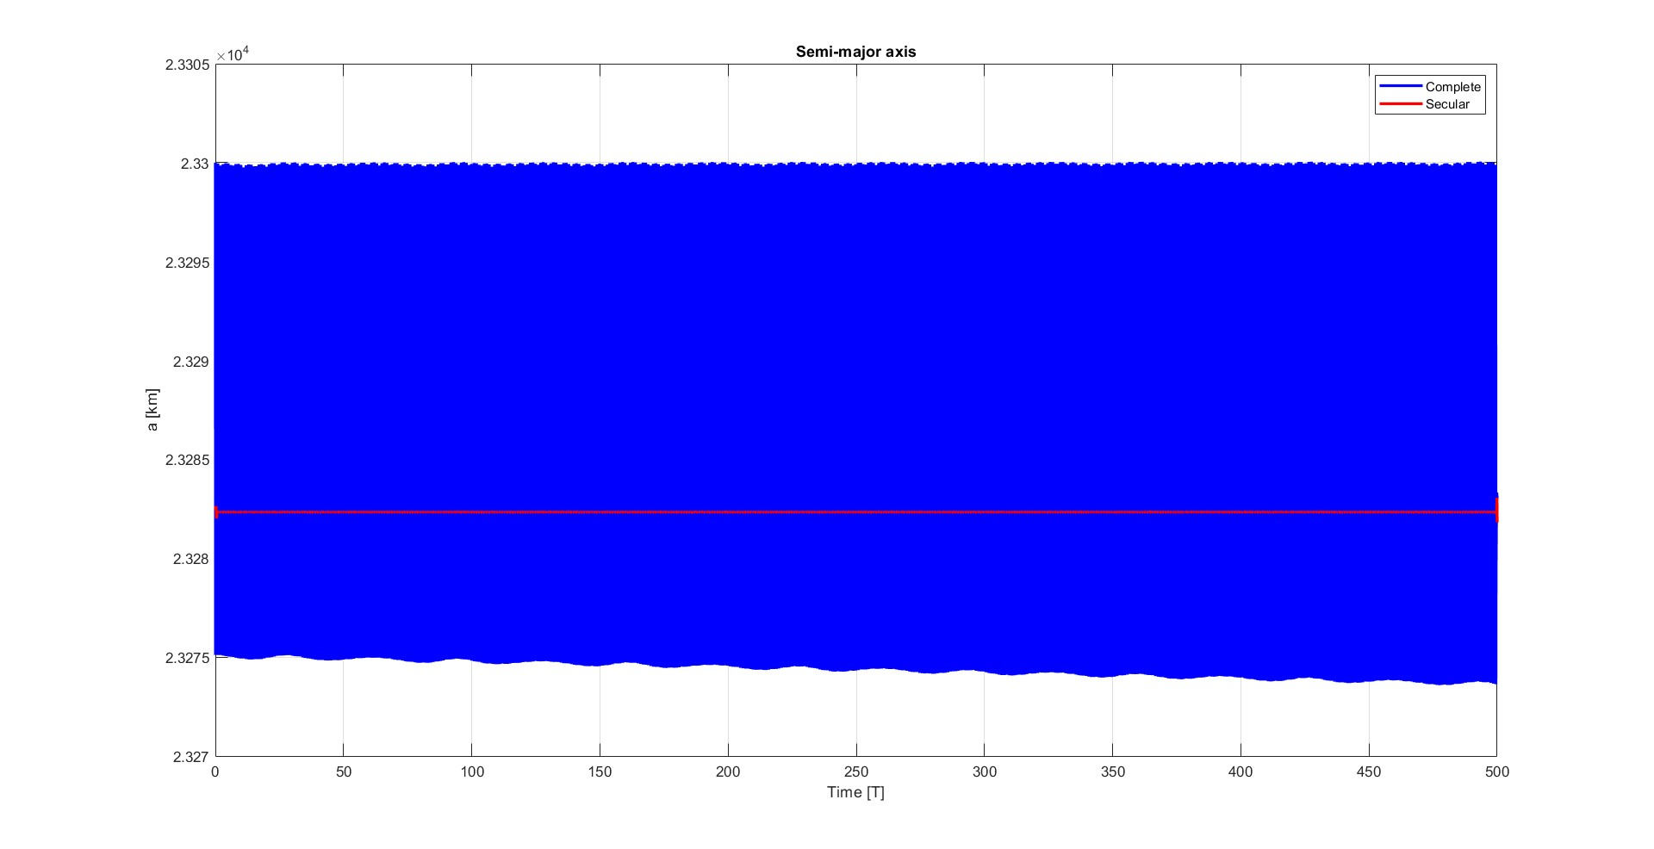
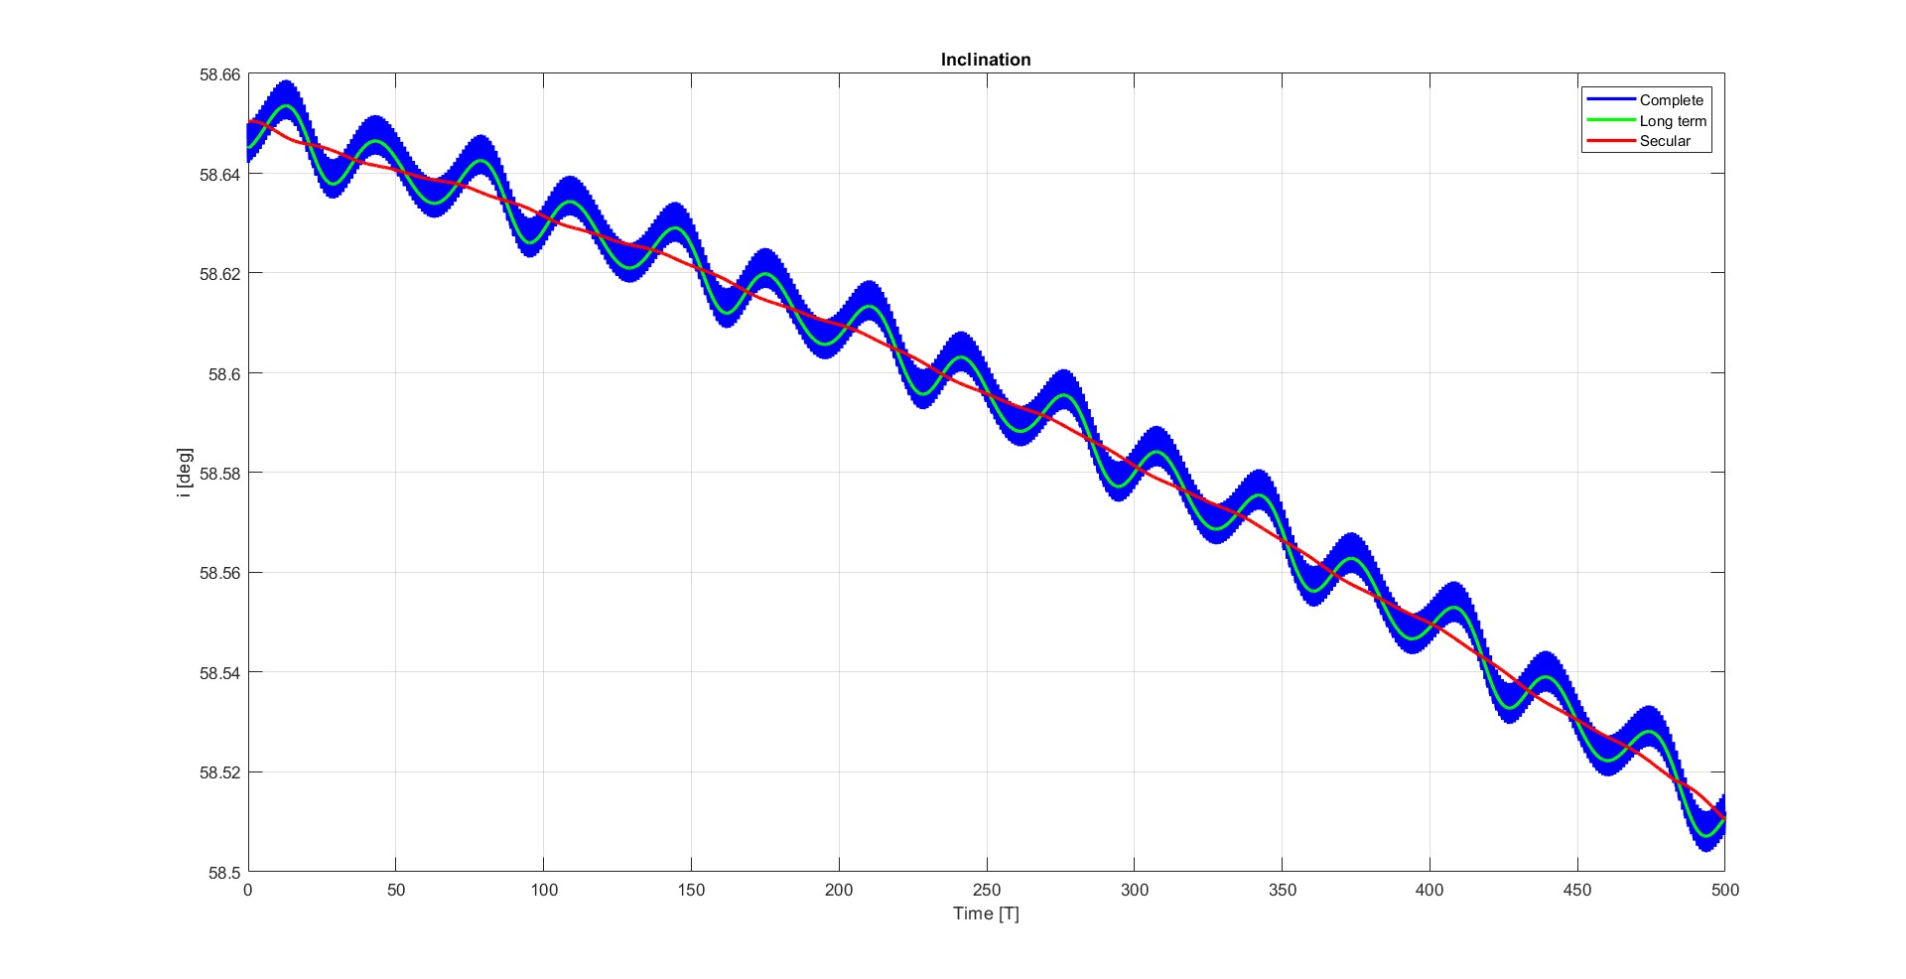
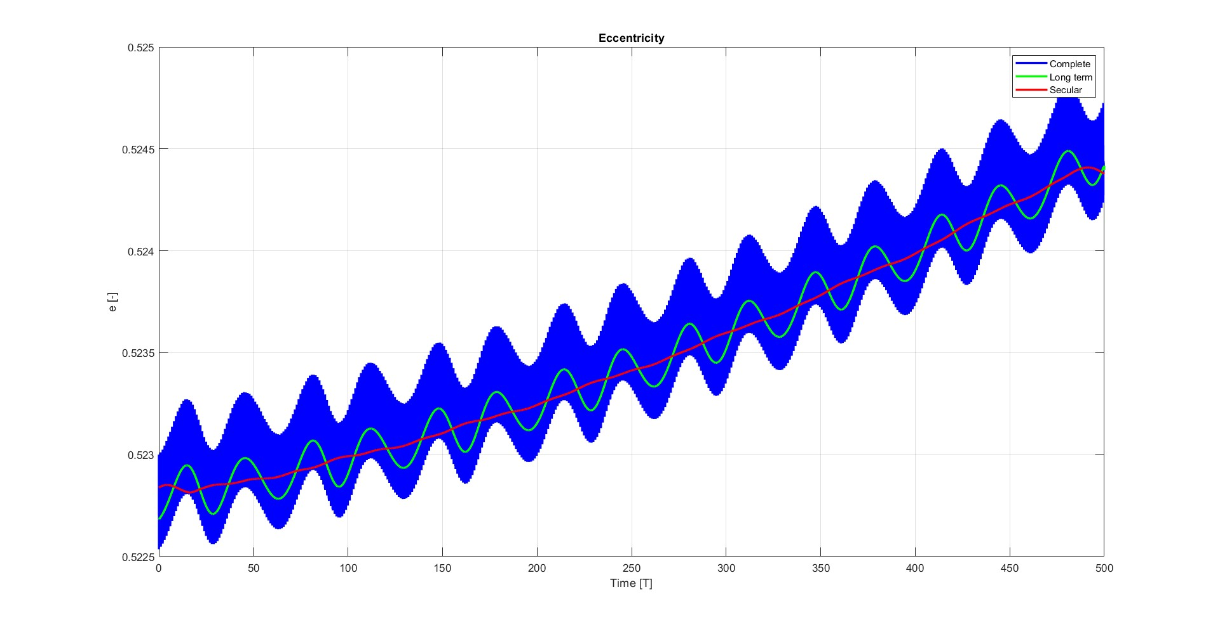
FILTERING OF KEPLERIAN PARAMETERS
Semi-major axis
Inclination
Eccentricity
Two oscillatory periods highlightened, filtered using movemean.m:
1 orbit periods frequency;
15 orbit periods frequency.

Slide 18
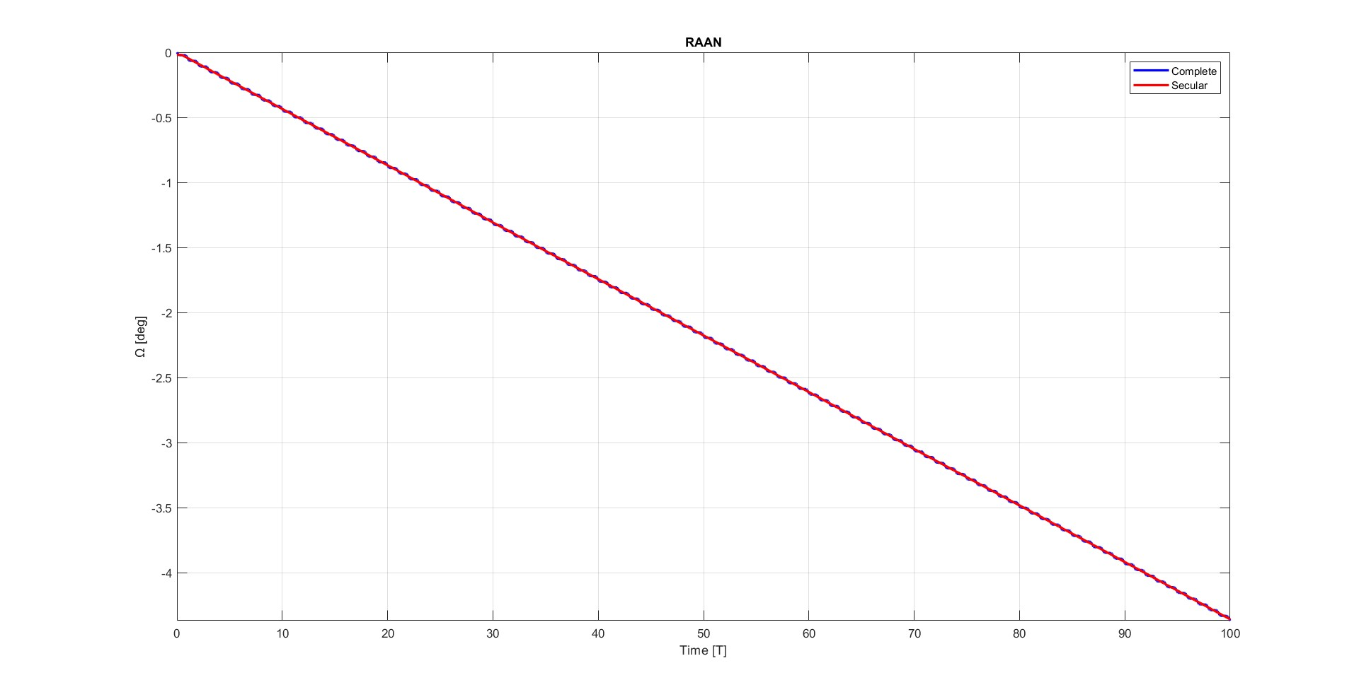
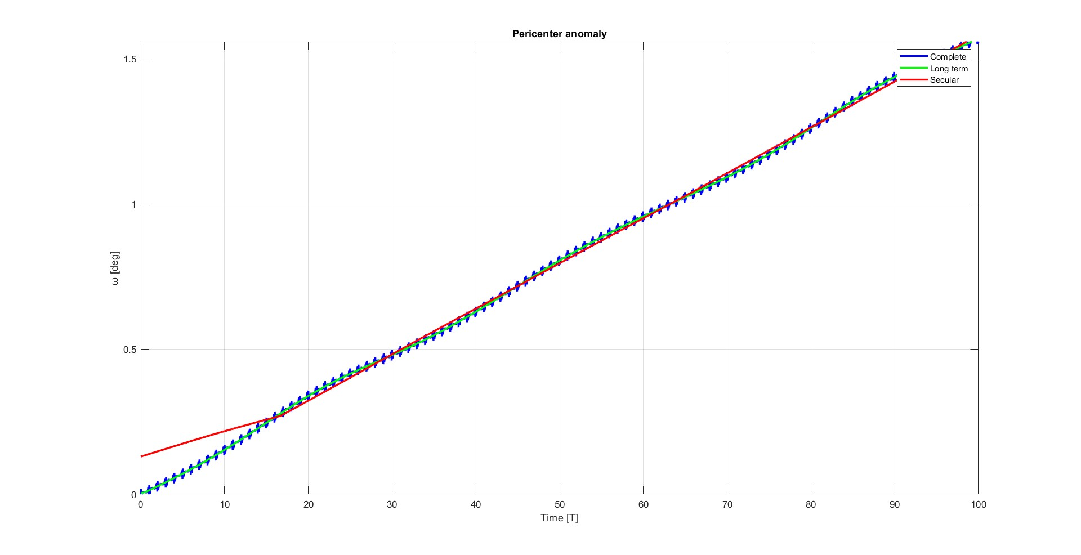
FILTERING OF KEPLERIAN PARAMETERS
RAAN
Perigee argument

Slide 19
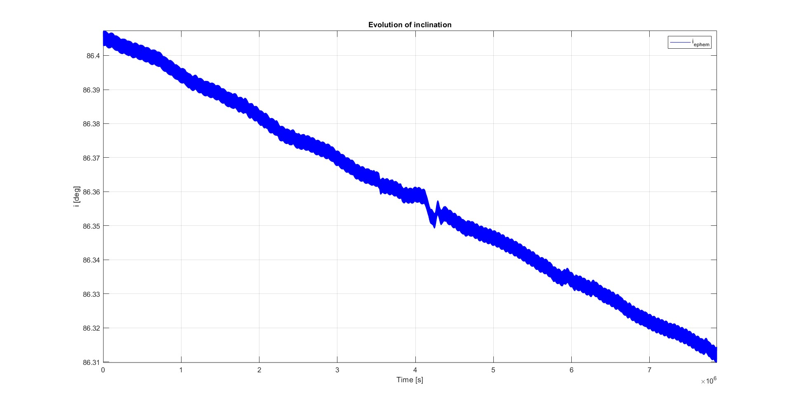
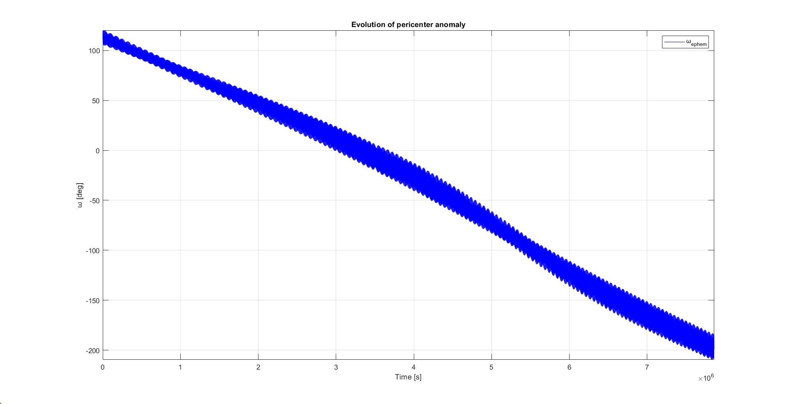
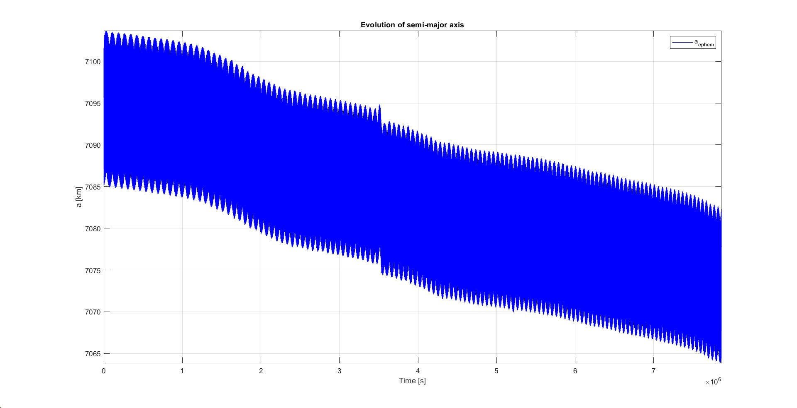
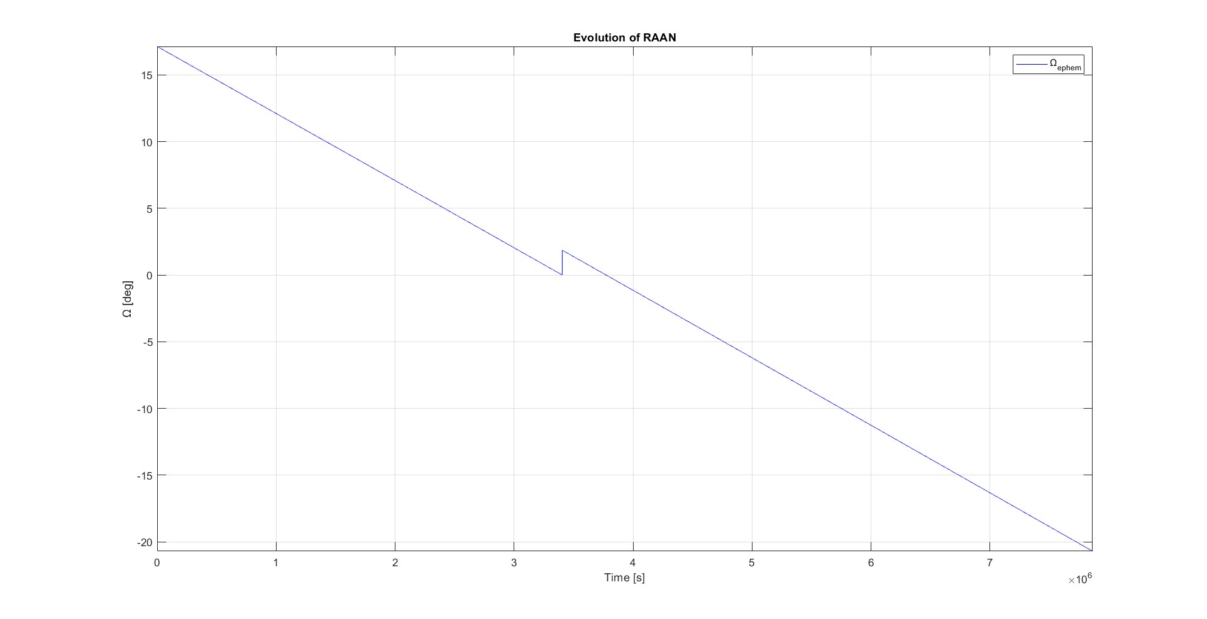
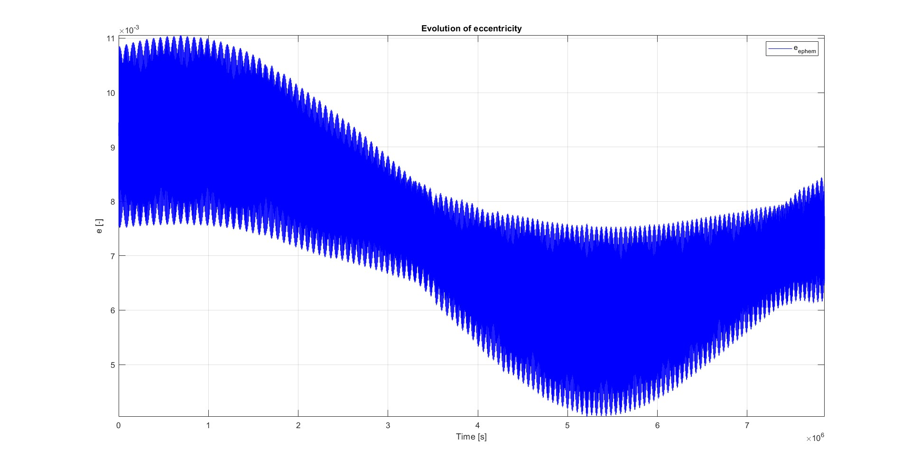
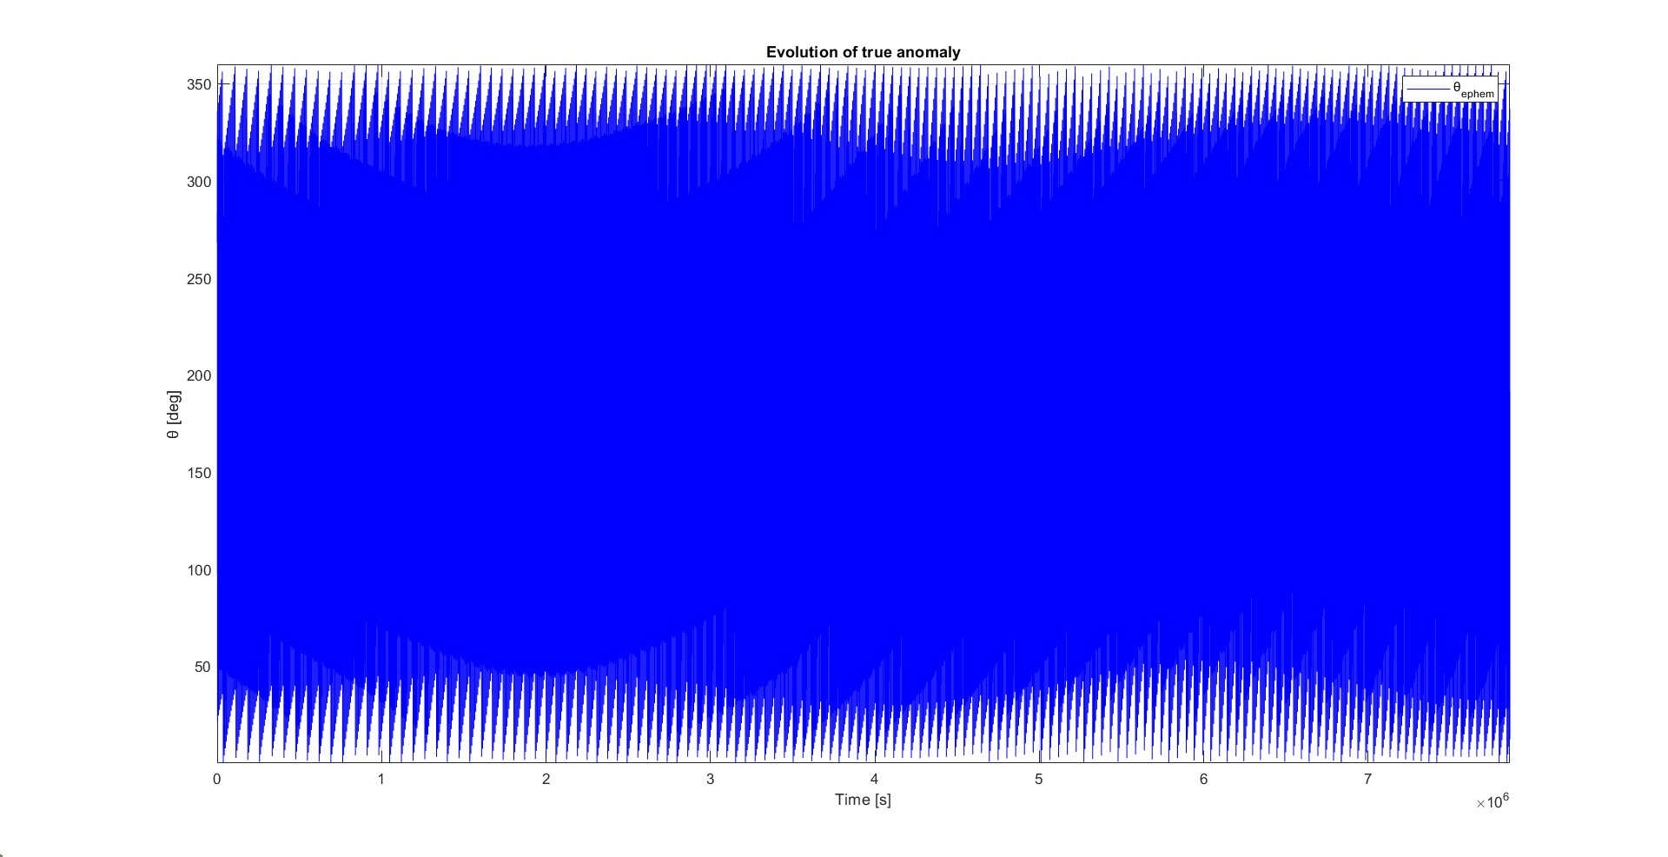
REAL DATA COMPARISON
IRIDIUM 33 debris
Semi-major axis
Russian communication satellite located in LEO, collided in 2009 with Kosmos 2251.
INITIAL ORBIT:
hp = 779.6 km;
i = 86.4 deg;
small e.
MAIN PERTURBATIONS:
Aerodynamic drag;
J2.
PROPAGATION PERIOD:
April 1, 2024 – July 1, 2024
Inclination
Perigee argument
Eccentricity
RAAN
True anomaly

Slide 20
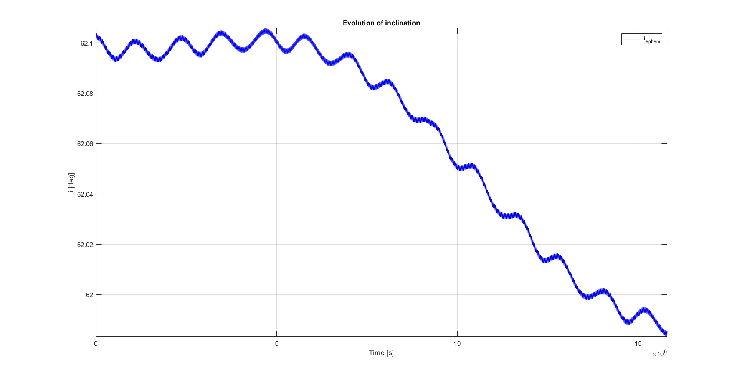
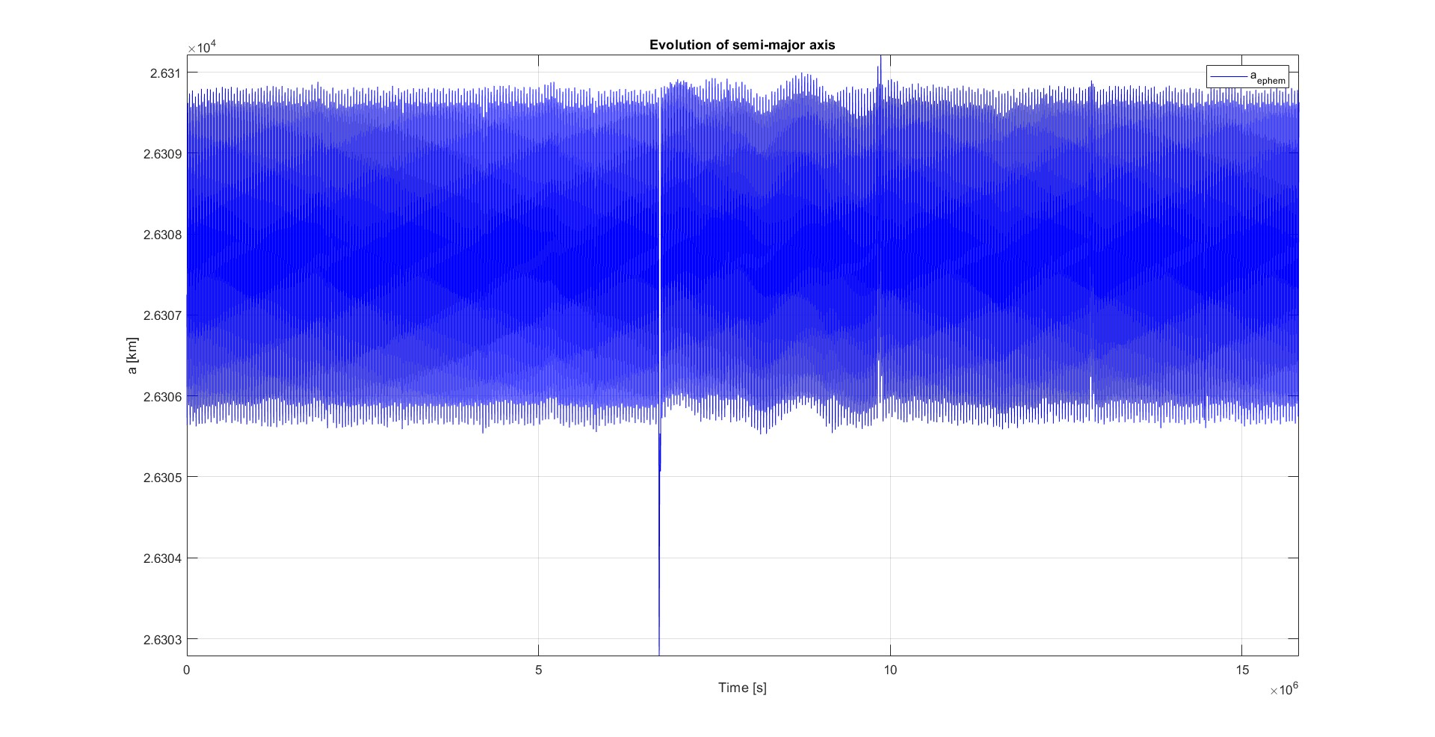
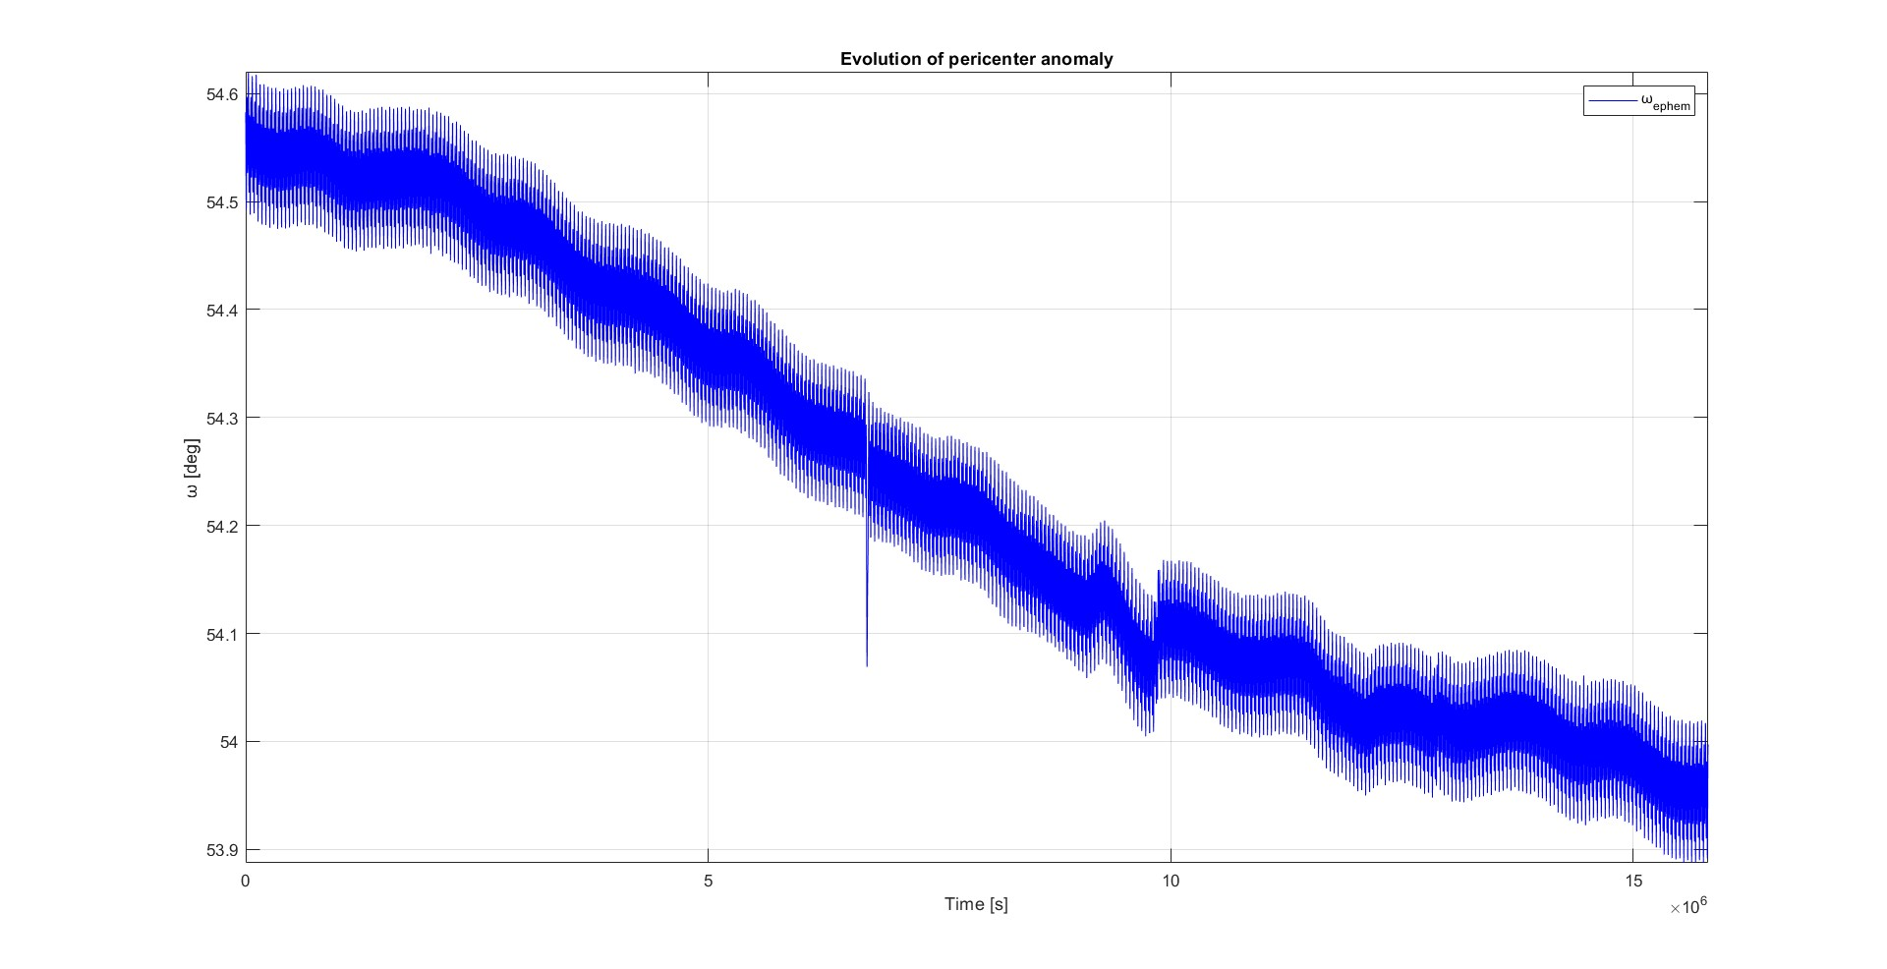
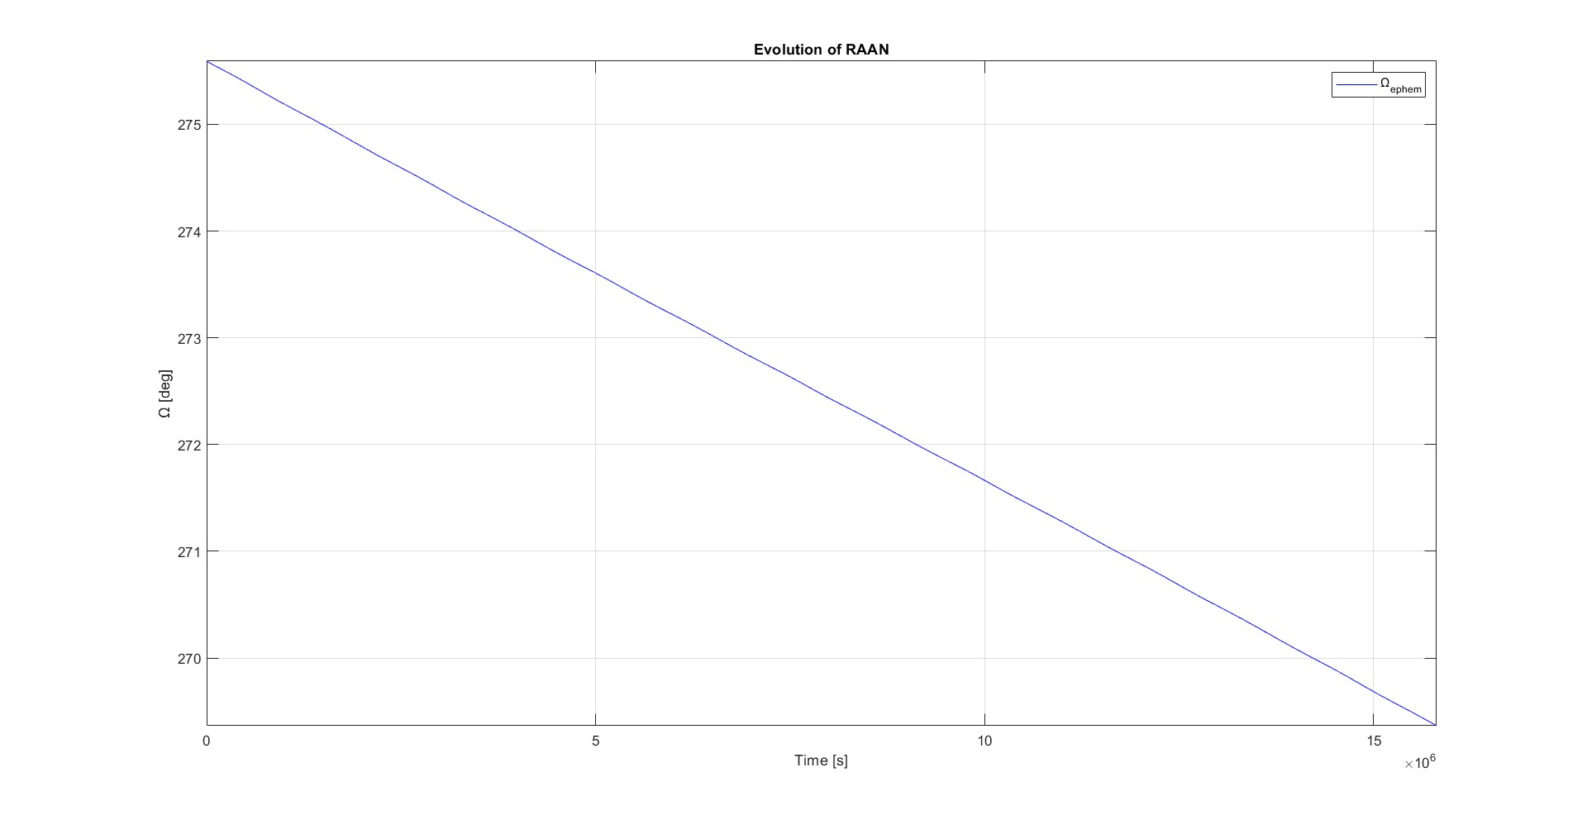
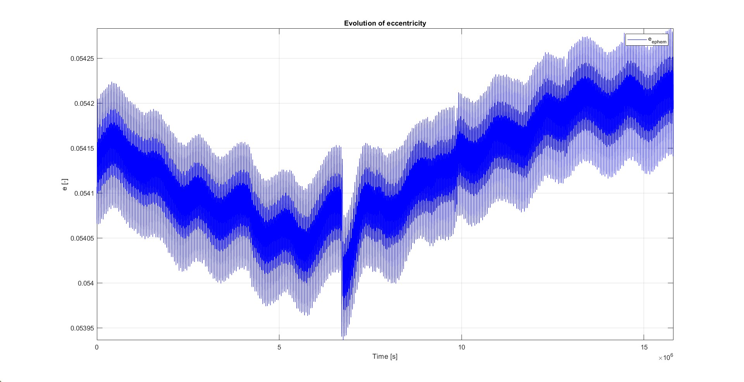
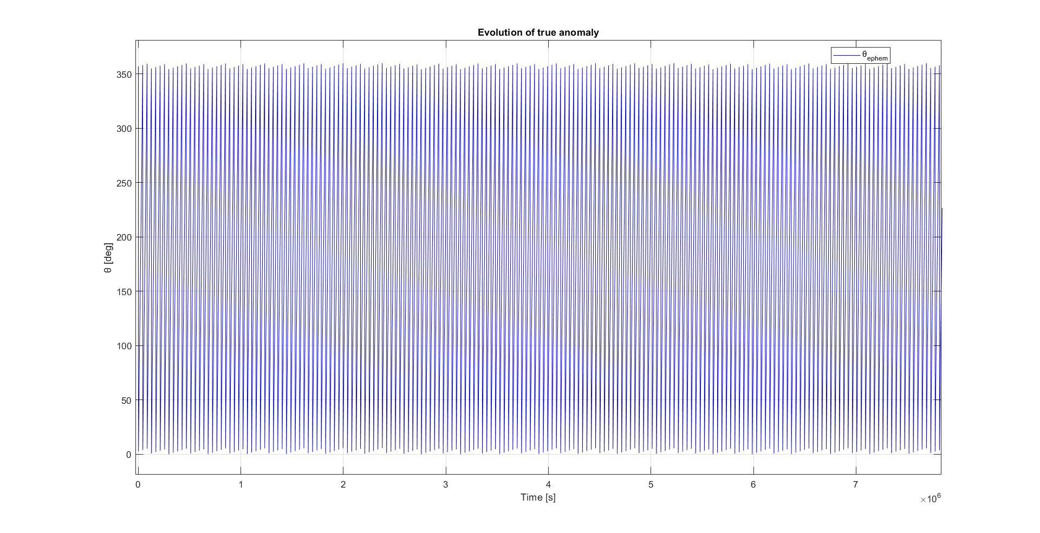
REAL DATA COMPARISON
Navstar 6
Semi-major axis
American navigation satellite located in MEO, retired in 1991.
INITIAL ORBIT:
hp =20006 km;
i = 62.8 deg;
small e.
MAIN PERTURBATIONS:
Third-body perturbation (Sun and Moon);
J2.
PROPAGATION PERIOD:
April 1, 2024 – October 1, 2024
Inclination
Perigee argument
Eccentricity
RAAN
True anomaly

